Slide 1

VTAR INSTITUTE 26TH GRADUATION CEREMONY 拉曼技职学院 第二十六届毕业典礼

Slide 2

26TH GRADUATION CEREMONY 第二十六届毕业典礼
Date 日期: 1st June 2024, Saturday 2024年6月1日，星期六
Time 时间: 7.00 am – 12.00 pm 上午7点 至 中午12点
Venue 地点: San Choon Hall, Level 2,Wisma MCA 马华大厦, 二楼，三春礼堂 163 Jalan Ampang, 50450 Kuala Lumpur.

Slide 3
PROGRAMME 节目
8.30 am Arrival of Guests 宾客抵达
8.40 am Arrival of Guest of Honour 主嘉宾抵达
9.00 am Graduands and Academic Procession 入场仪式
9.10 am National Anthem 国歌
9.15 am Welcome Address & Graduation Address 致辞 Presentation of Graduands 介绍毕业生 Presentation of Certificates 颁发证书 Presentation of Best Student Awards 颁发最佳学生奖 Token of Appreciation 致谢礼篮 Recessional 离场仪式
10.45 am Group Photography Session 团体合影
Press Conference 新闻发布会
Refreshment 茶点
12.00 pm End of Event 活动结束

Slide 4
GRADUANDS’ ITINERARY 毕业生行程
7.00 am Graduands arrival 毕业生抵达
Collect gown and dress up 领取毕业跑和装扮
8.35 am Ready at holding area 在等候区准备就绪
8.55 am Graduands Procession 入场仪式
9.00 am to 10.45 am
Graduation Ceremony + Group Photo in hall
毕业典礼 + 团体合影
11.20 am Return gown 归还毕业袍
11.30 am Collect certificate 领取证书
Refreshment (Parents & Guest) 茶点（父母和宾客）
12.00 pm END of program 活动结束

Slide 5

DRESS CODE – OFFICE ATTIRE 着装要求—办公室着装
Male 男
White/Soft Coloured Shirt 白色/柔和的彩色衬衫
Tie 领带
Black long pants 黑色长裤
Black/dark coloured shoes 黑色/深色鞋子
Female 女
White/Soft coloured blouse 白色/柔和的彩色上衣
Black long pants/Black skirt 黑色长裤/黑色裙子
Black/dark coloured court shoes 黑色/深色包鞋

Slide 6
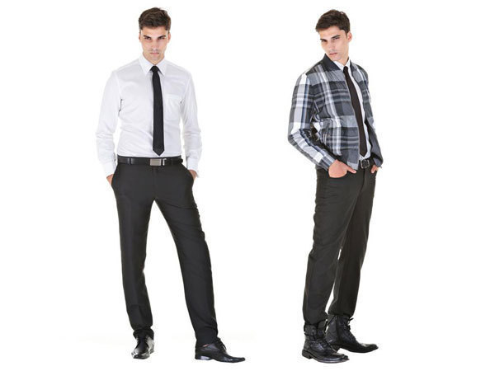
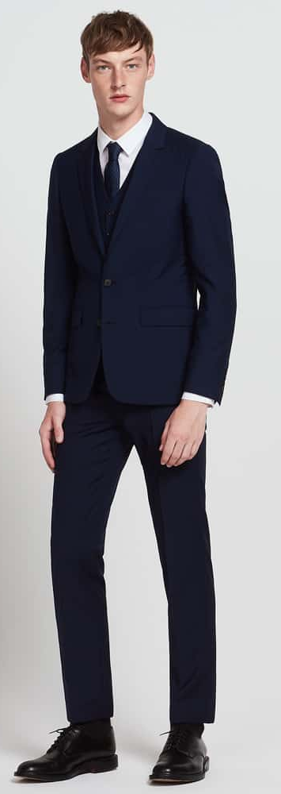
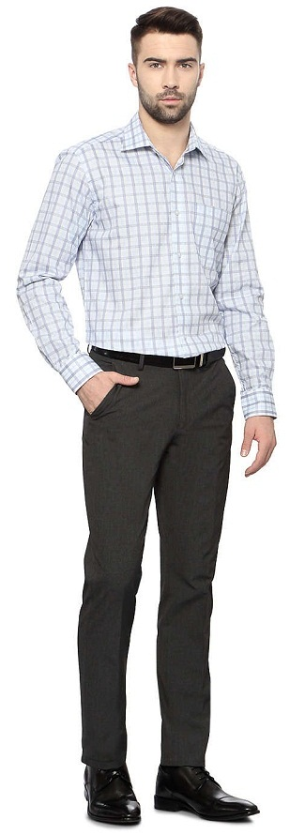


Slide 7
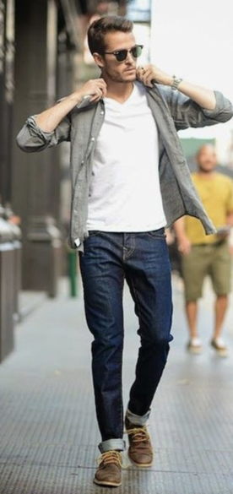
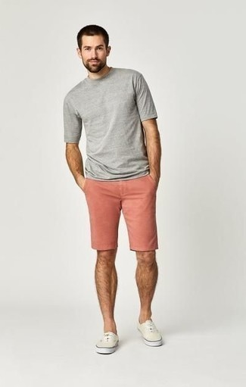
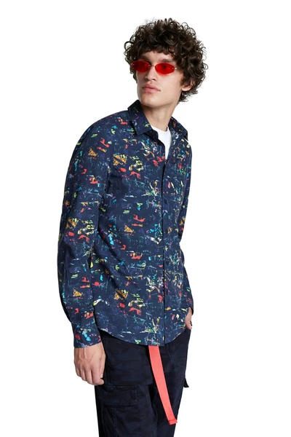
X

Slide 8
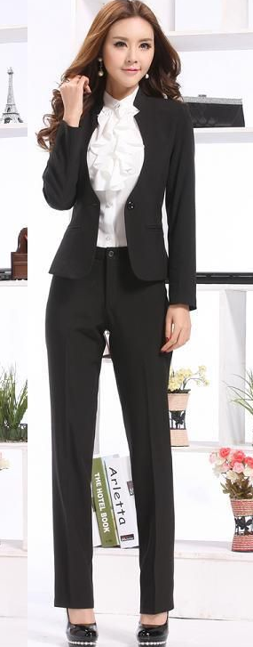
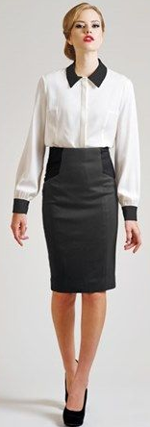
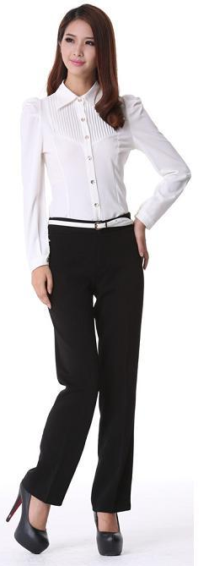
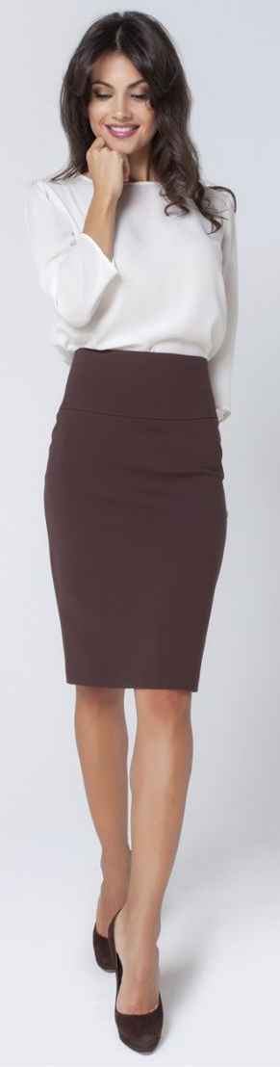

Slide 9

X

Slide 10
DRESS CODE 着装要求
Strictly NO 绝对不
T-shirts T恤
Shorts 短裤
Jeans 牛仔裤
Sneakers/Sport shoes 球鞋/运动鞋
Sandals 凉鞋

Slide 11
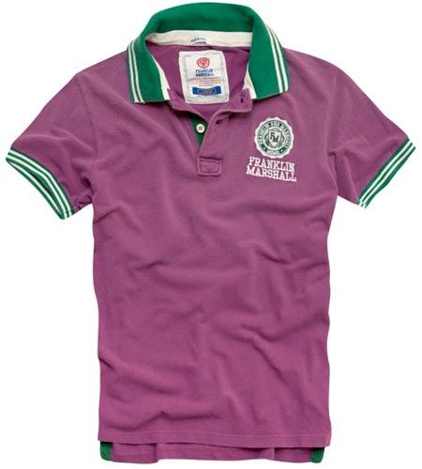


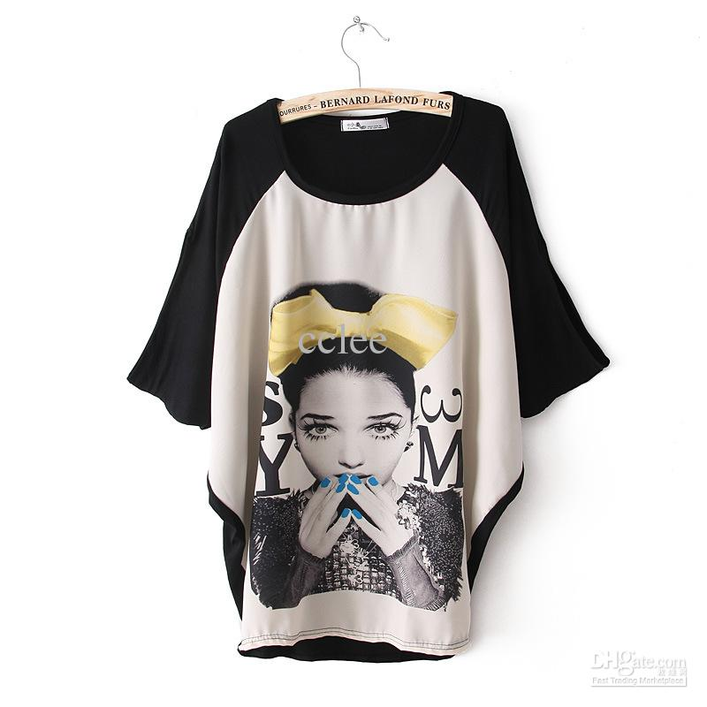
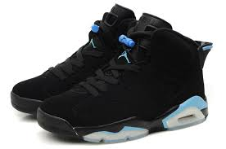
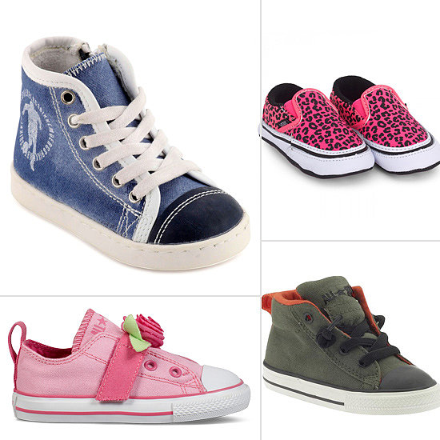
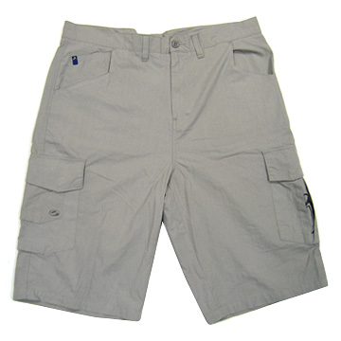
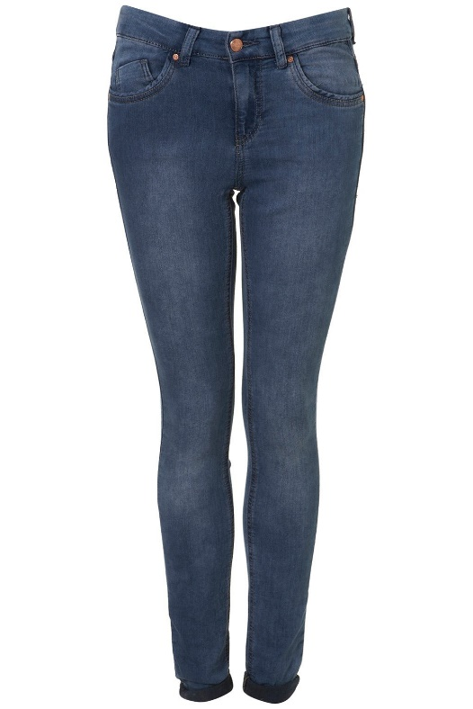
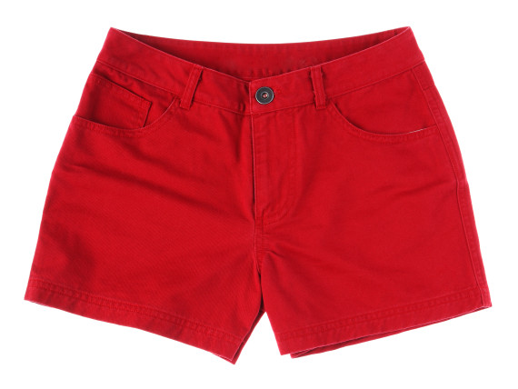
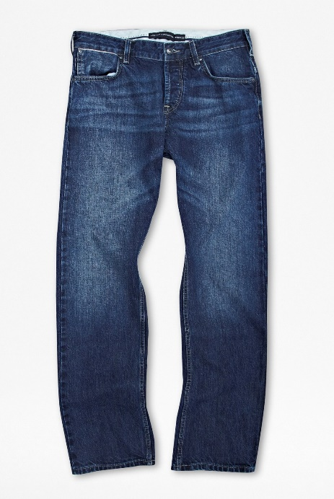
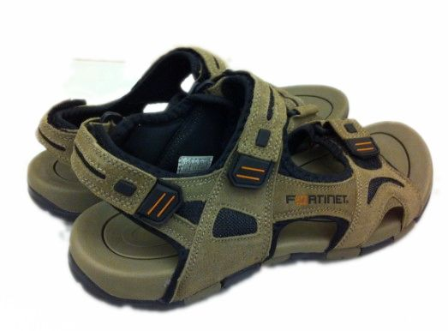
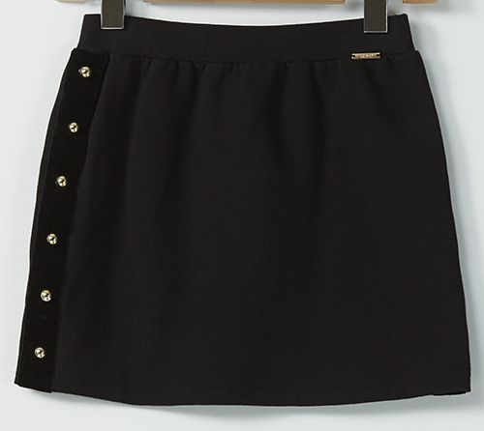
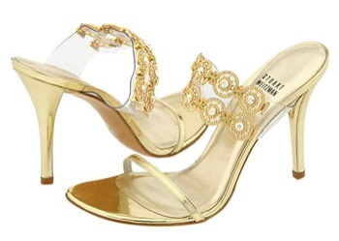
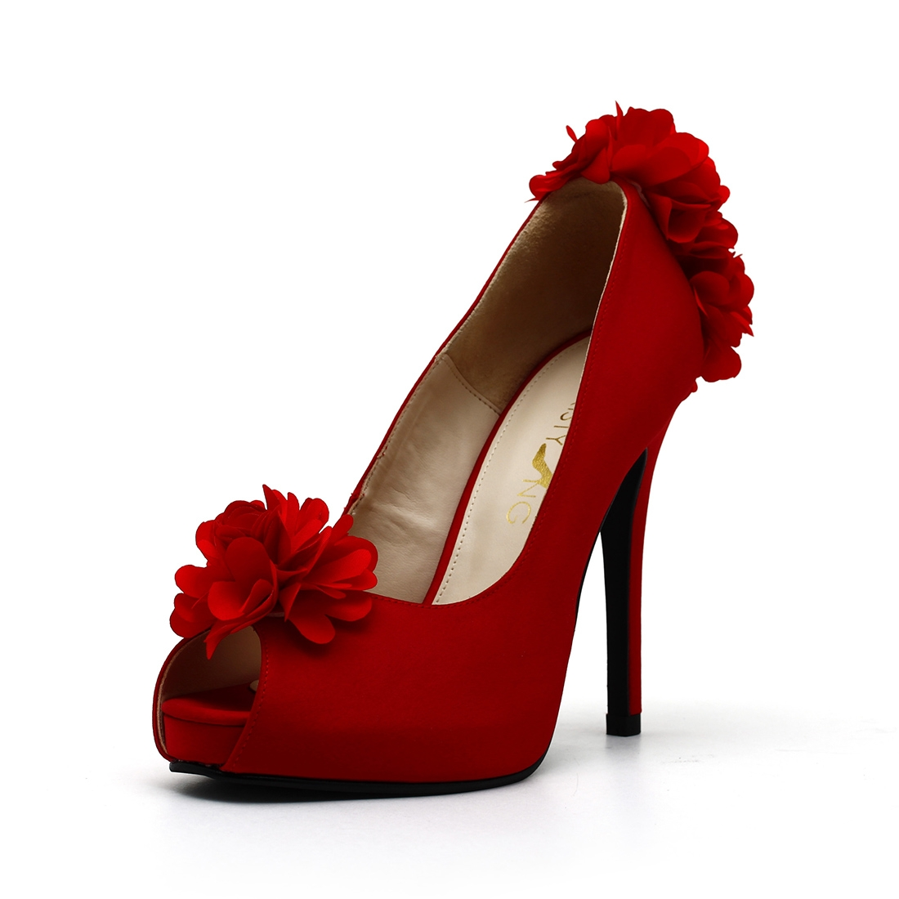
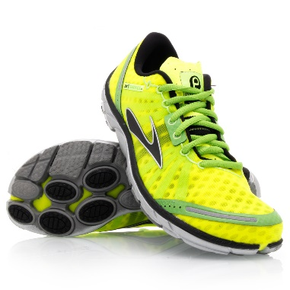
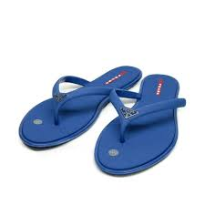
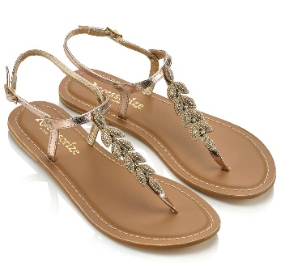
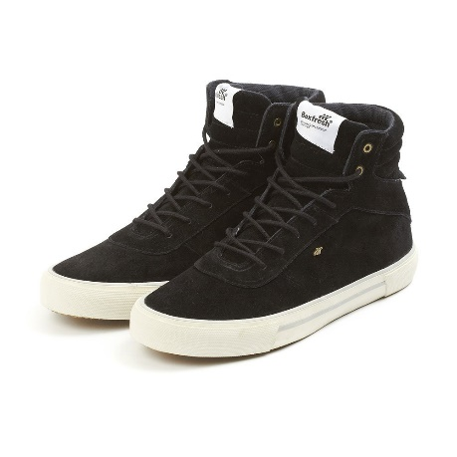

Slide 12
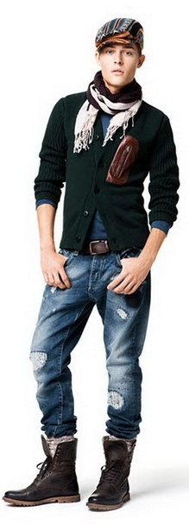
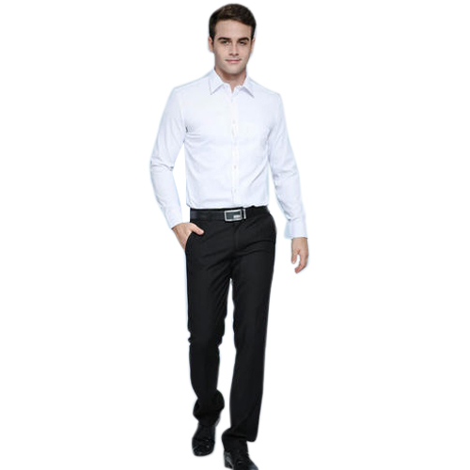
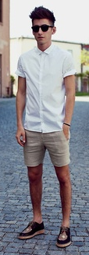
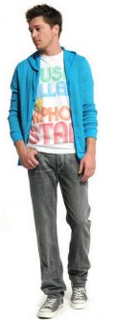



Slide 13
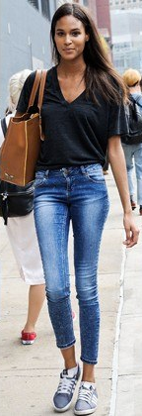
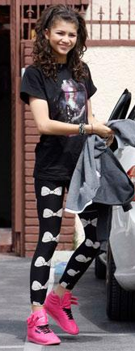
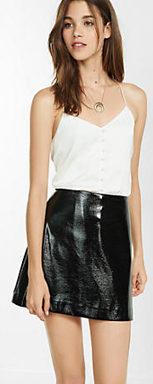


Slide 14
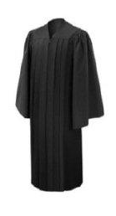
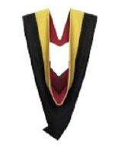
GOWNS AND HOODS 毕业袍和垂巾
Black gown 黑袍
Hoods colour 垂巾颜色
Electronic - Light Blue
Beauty - Purple
Electrical - Orange
Hairdressing - Green
Bakery - Yellow
Precision Mould- Red

Slide 15
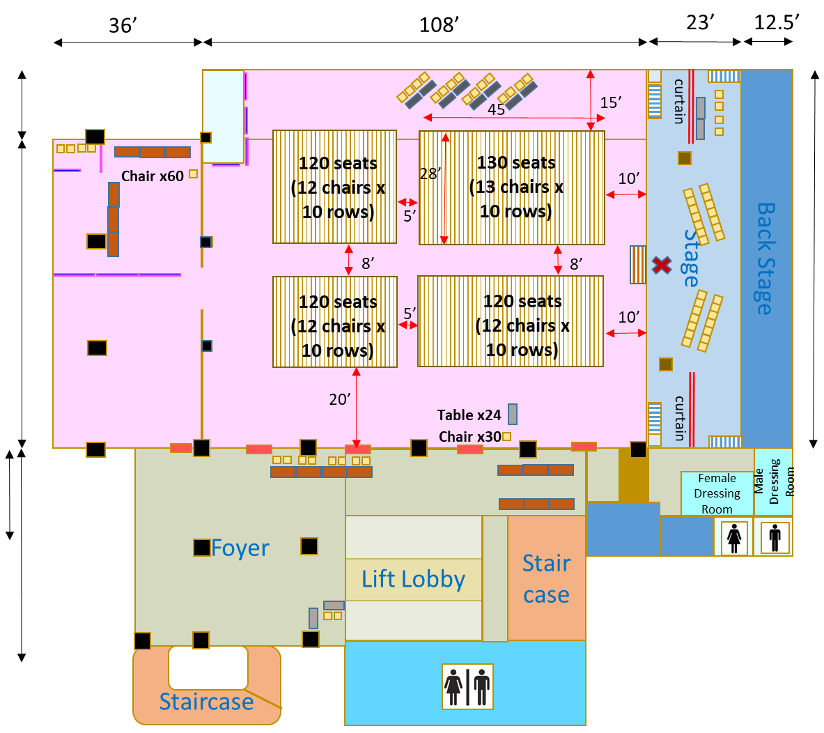



VTAR 26TH GRADUATION CEREMONY 拉曼技职学院 第二十六届毕业典礼 1st JUNE 2024
San Choon Hall, Level 2, Wisma MCA
马华大厦, 二楼，三春礼堂
Press/Certificate Collection
Parents & Guests
Graduands
Level 3 Foyer, Wisma MCA
马华大厦, 三楼门厅
Refreshment
(vip & staff)
Parents & Guests
Parents & Guests
VIP
Exhibition
Foyer
Gown Collect / return COUNTER
Exhibition
BKR
HD
IE
BT
EE
EDM
Lift Lobby
Stair case
Parents, Guests & Press Registration
Refreshment
Staircase
florist

Slide 16
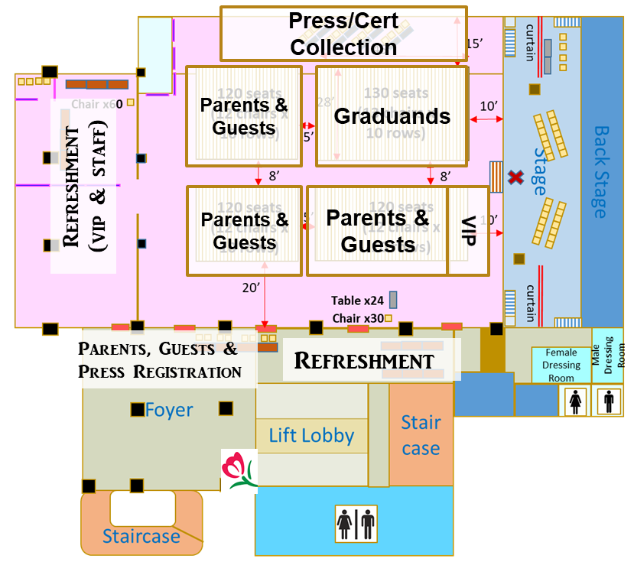

GRADUANDS PROCESSION 毕业生入场
Exhibition
florist

Slide 17
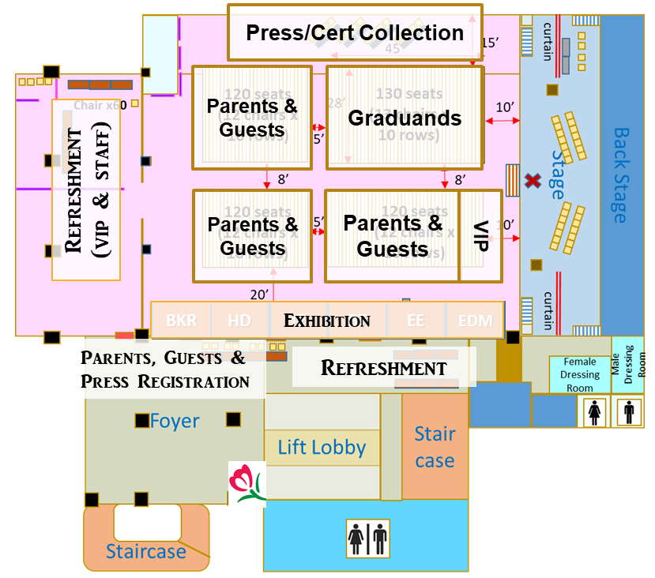
RECEIVING SCROLL 接收卷轴
florist

Slide 18
REMINDERS 提醒事项
One invitation QR Code for one guest. 一位宾客一个邀请二维码。
Parents or guests without the invitation QR Code are NOT allowed to enter the hall. 没有邀请二维码的父母或宾客不得进入大厅。
Cashless Car Park (Flat rate RM 7 per entry) 无现金停车场 （平率 RM 7 per entry)
Touch ‘n Go / Credit / Debit Card only 只允许使用Touch ‘n Go / Credit / Debit Card
Cars can be parked at basement of Wisma MCA
汽车可以停在马华大厦的地下室

Slide 19
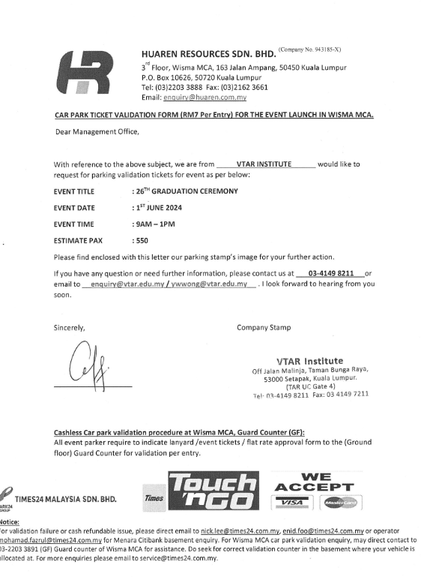
REMINDERS 提醒事项
All Graduands, Parents and Guests are required to indicate the below flat rate application form to the Guard Counter (Ground Floor) for validation per entry. 所有毕业生，父母和宾客都需要向警卫柜台（一楼）显示以下的表格，以便获得 RM 7 per entry。

Slide 20
REMINDERS 提醒事项
Parents and Guests should arrive before/at 8.30 am and must be seated latest by 8.50 am. 家长和宾客应在上午 8.30 之前/准时到达，并且最迟必须在上午 8.50 就座。
Late comer will not be allowed to enter to the hall. 迟到者不得进入会场。
Graduands and guests are advised to remain in their seats throughout the ceremony. 建议毕业生和宾客在整个仪式进行时都留在座位上。

Slide 21
REMINDERS 提醒事项
Graduands are MUST NOT lost the name tag given 毕业生不得丢失给定的姓名名牌
Graduands are NOT allowed to carry bag when entering the hall. 毕业生进入大厅时不得携带手提包/背包。
Mobile phone must be in silent mode. 手机必须处于静音模式并放在口袋里。
Graduands come late, after 8.30am are not allowed in processional and receiving scroll. 早上8.30 之后迟到的毕业生，不允许参加入场仪式和接收卷轴。

Slide 22
ANNOUNCEMENT 通告
Flowers can be purchased at Wisma MCA, Level 2
鲜花可在 马华大厦, 二楼 购买
Graduands are required to collect gown at Level 3 upon arrival.
毕业生抵达时，必须到 三楼 领取毕业袍。
Parents and Guests need to register at Level 2 upon arrival and enter the hall.
家长和宾客抵达后，必须到 二楼 登记并进入礼堂。
After the ceremony, graduands are required to return the gown at Level 3, and proceed to Certificate Collection Counter to fill up google form in order to claim certificate and VTAR Magazine.
仪式结束后，毕业生需要在 三楼 归还毕业袍，然后再前往证书领取柜台填
写表格以领取证书和 VTAR 校刊。

Slide 23

THANK YOU
谢谢

